Slide 1

Analyzing swiggy
By – Gouthamram Puranik

Slide 2
ABSTRACT :
The online food ordering market has witnessed significant growth and diversity in recent years, encompassing various types of food services, including restaurants, independent individuals, and grocery delivery. The concept of ordering food online originated in 1995 with the establishment of World Wide Waiter, now known as Waiter.com. Online food ordering involves the convenient process of placing food orders through websites or applications, covering both ready-to-eat meals and food items that require preparation. This abstract provides an overview of the online food ordering market, its historical background, and the broad scope it encompasses, highlighting the dynamic nature of this evolving industry.

Slide 3
Problem Statement :
The online food ordering market includes foods prepared by restaurants, prepared by independent people, and groceries being ordered online and then picked up or delivered. The first online food ordering service, World Wide Waiter (now known as Waiter.com), was founded in 1995. Online food ordering is the process of ordering food from a website or other application. The product can be either ready-to-eat food or food that has not been specially prepared for direction consumption.
Do ETL : Extract-Transform-Load the dataset and find for me some information from this large data. This is form of data mining.
Find key metrics and factors and show the meaningful relationships between attributes.
Do your own research and come up with your findings.

Slide 4
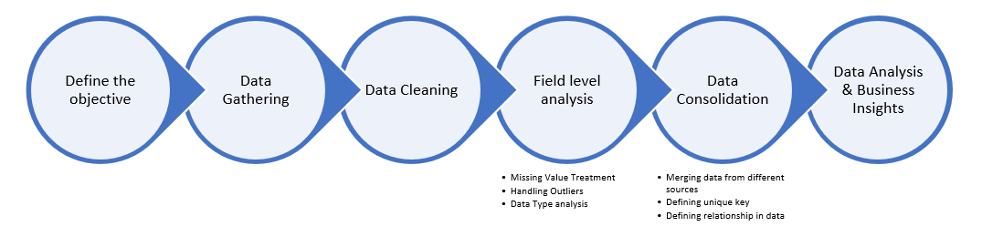
ARCHITECTURE:

Slide 5
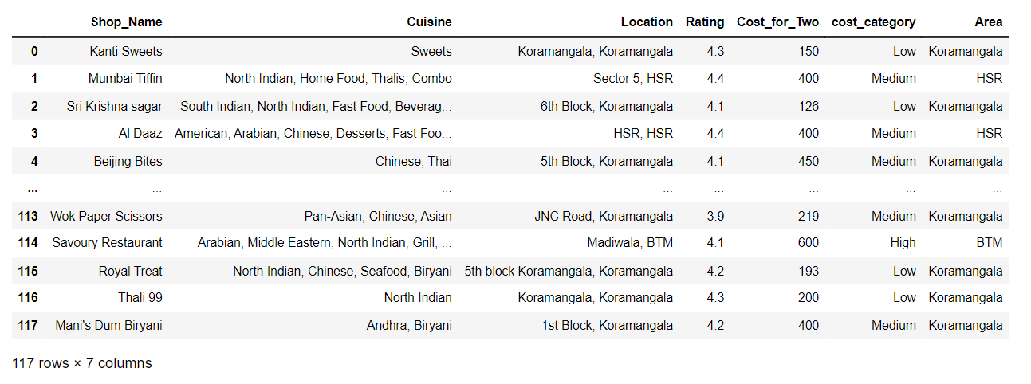
Dataset after data-cleaning and processing:

Slide 6
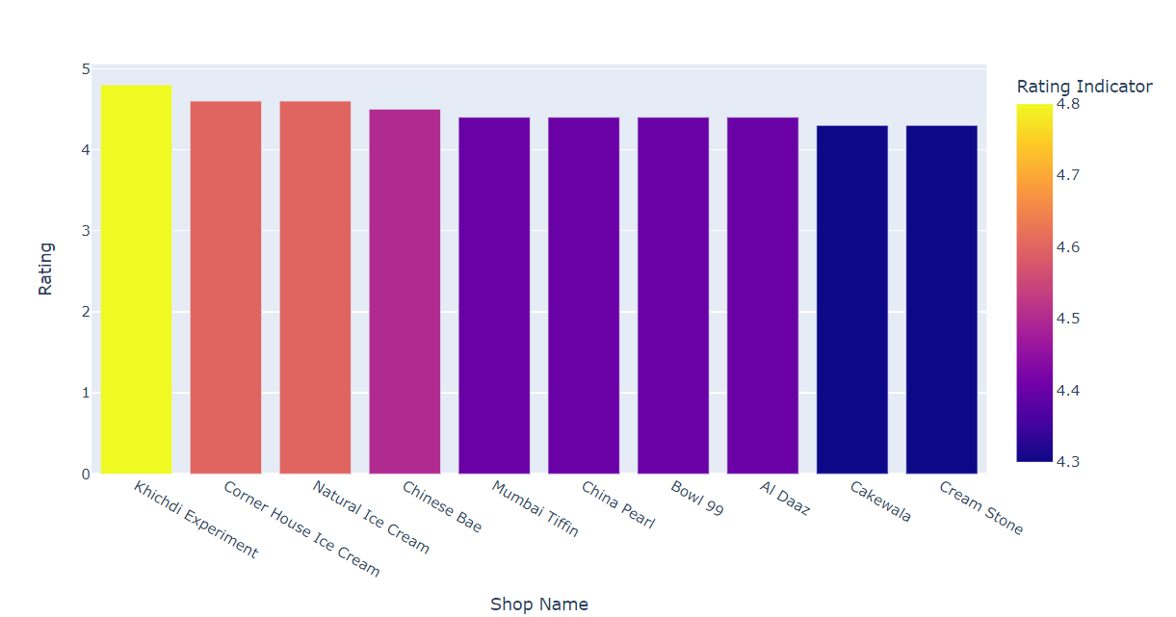
Top 10 Hotels with High Ratings :

Slide 7
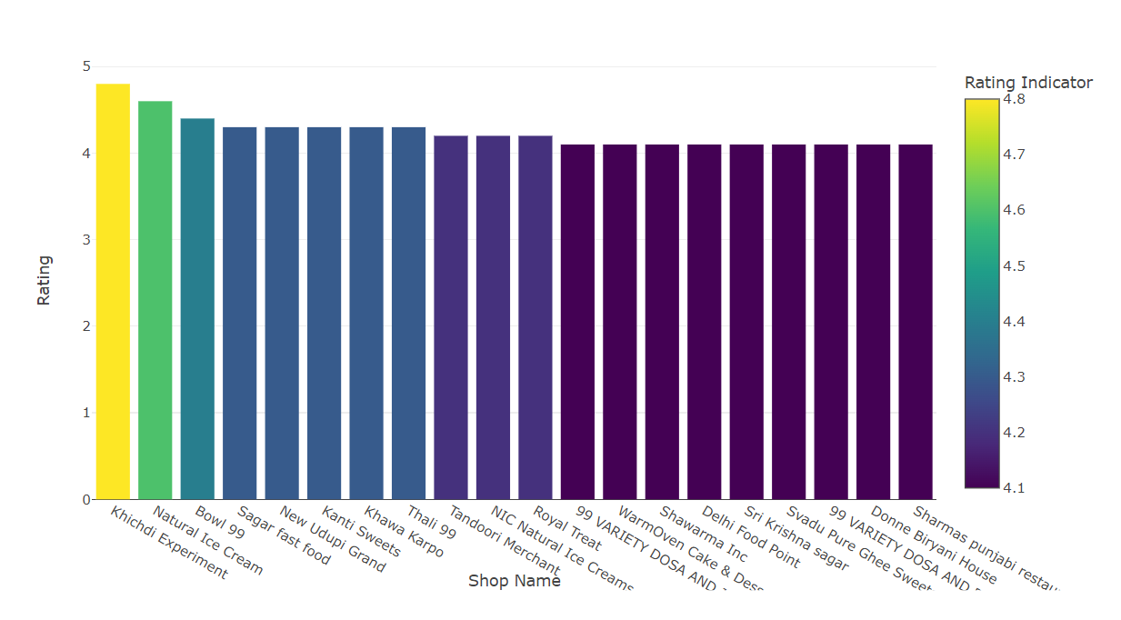
Hotels with High Ratings and Low Price :

Slide 8
Cuisines with High Ratings :

Slide 9
Pie chart for Distribution of Cost Category :

Slide 10
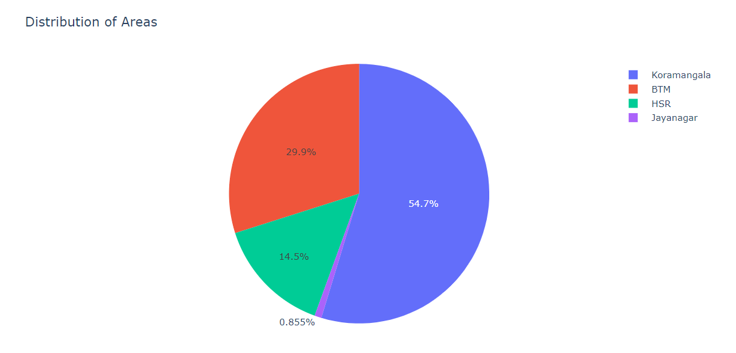
Pie chart for Distribution of Area:

Slide 11
Area-wise analysis:
Koramangala –
In Koramangala area, The average Rating is 4.13
Average Cost for two person is 297.83
max orders lies in medium cost category
HSR –
In HSR area, The average Rating is 4.07
Average Cost for two person is 391.18
max orders lie in medium cost category which is 64.7% and Low & High cost category are of 17.6%
BTM-
In BTM area, The average Rating is 4.05
Average Cost for two person is 329.09
Max orders lie in medium cost category which is 82.9%

Slide 12
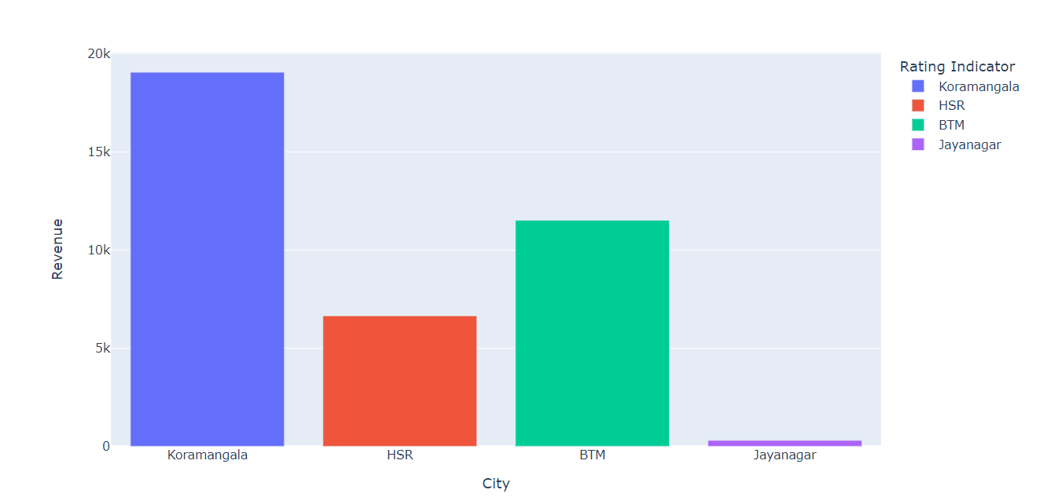
Revenue w.r.t Area :

Slide 13
THANK YOU

